Slide 1
Trajectory
how people & objects move and how
children can affect that movement
e.g. they drop objects, jump, swing, kick, throw, climb up & down
Key Words
FLY, SPIN, TWIRL, GLIDE, FLOAT, DROP, BOUNCE, HIGH, LOW, HEAVY, LIGHT. LAND, TARGET,
TAKE OFF, SWING, PENDULUM, PULLEY,
UP, DOWN, FAST, SLOW

Slide 2
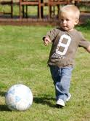
Children with this schema may enjoy:
Blow bubble, feathers or chiffon scarves
Squeezy or spray bottles
Make kites
Hoopla & skittles
Tubes & funnels in the water
Marble Run, marble painting
Balls of different sizes & weights
Yo-yo
Beanbags & target
Fly paper aeroplanes
Hoops to roll & pipes to slide things down
Jump on a trampoline
Slalom course for bikes

Slide 3
Connecting
fastening & joining things together
and taking them apart
e.g. they join train tracks, attach ropes, are fascinated by string
Key words
BUILD, CONSTRUCT, JOIN, SEPARATE, OPEN, CLOSE, TOGETHER, APART,FLEXIBLE, RIGID, STRONG, HEAVY, LIGHT, TIE, KNOT, THREAD, STITCH

Slide 4
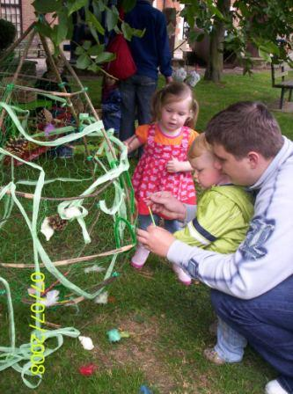
Children with this schema may enjoy:
Weaving with natural materials or ribbon
Wood, hammer & nails
String, tape, elastic bands
Hanging mobiles, flags & kites
Train tracks
Magnets
Threading pasta or beads
Making trailers for bikes
Washing lines & pegs
Looking at spiders webs or scaffolding

Slide 5
Rotation
things that turn
e.g. they use keys, turn knobs, run or ride in circles, spin around,
make circle & spiral patterns in paint etc.
Key Words
FLY, SPIN, TWIRL, ROUND, CIRCLE, TWIST,
ROLL, DIZZY, SPIRAL, FASTER

Slide 6
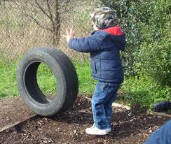
Children with this schema may enjoy:
Locks & keys
Mixing & stirring
Use paint rollers
Spanners & screwdrivers
Sharpen pencils
Balls of all descriptions
Make ribbon sticks & paper windmills
Roll old CDs & jar lids
Spinning & wind up toys
Spirals - snail shell, springs
Kaleidoscopes
Cameras, cogs & clocks

Slide 7
Orientation
seeing things from different angles
e.g. they hang or stand upside down,
turn their toys upside down as they look at them
Key Words
TURN, UPSIDE DOWN, BACKWARDS, OVER,
TWIST, ROLL, UNDER

Slide 8
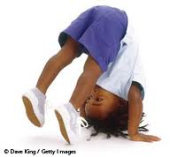
Children with this schema may enjoy:
Kaleidoscopes
Mirrors
Magnifying lenses
Binoculars
Posting boxes
Peep holes
Pendulums
Climbing/swinging
Twisting & spinning
Moving like animals or to music
Headstands, rolling & tumbling
Low bars to swing & hang from or roll over
Mirrors in unusual places e.g. floor or ceiling

Slide 9
Enveloping
covering or wrapping up objects
or themselves,
putting things inside containers
e.g. they drape themselves in fabric, make parcels, paint their hands
Key Words
UNDER, OVER, IN, ON, ABOVE, BELOW, SIZE WORDS, INVISIBLE,
TRANSPARENT/OPAQUE, HIDDEN, WRAP/UNWRAP,
HERE/GONE, FULL/EMPTY

Slide 10
Children with this schema may enjoy:
Long lengths of fabric
Origami & lift the flap books
Dressing up
Russian dolls or nesting boxes
Wrapping presents or playing pass the parcel
Toys with doors & keys
Burying treasure
Making & playing in dens
Dolls & blankets
Boxes, bags & baskets for collections of objects
Layering collage materials, newspaper or paint
Kim’s memory game

Slide 11
Positioning
placing objects or themselves
in patterns or rows
e.g. they line up toys, position them either on top, around the edge,
under, behind or next to each other
Key Words
INSIDE, ON TOP, UNDER, BEHIND,
BETWEEN, NEXT TO, IN FRONT

Slide 12
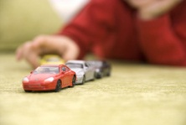
Children with this schema may enjoy:
Creating elaborate frames for pictures
Sorting small objects
Making mosaics with collage materials
Making pictures with shapes
Games involving hiding & finding objects
Stacking or lining up objects
Creating layers
Balancing objects along edges
Activities with small or multiple pieces

Slide 13
Transporting
moving themselves around
& transporting objects
e.g. using bags, bikes, trucks etc.
Key Words
IN, ON, UNDER, EMPTY, FULL, BRIMMING, OVERFLOWING,
ALL GONE, MORE, AGAIN, IN & OUT, OPEN & CLOSED,
ALMOST, SAME & DIFFERENT

Slide 14
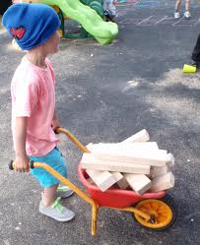
Children with this schema may enjoy:
Diggers & dumper trucks with sand/gravel
Water with jugs & buckets
Wheelbarrows or pushchairs
Bags, boxes & baskets
Shopping games
Rice, ice cube tray & tiny spoons
Empty the pan cupboard
Delivering letters
Treasure baskets
Pulleys & ropes
Play moving house

Slide 15
Enclosing
creating & occupying enclosed spaces
e.g. they create structures to enclose themselves or objects. Spaces may be filled or left empty
Key Words
POSITION & SIZE WORDS, ENCLOSE, WRAP, CONTAIN, SAFE,
INSIDE, OUTSIDE, BOUNDARY, EDGE, MARGIN, CORNER, SIDE,
ENTRANCE, EXIT, WAY IN/OUT

Slide 16
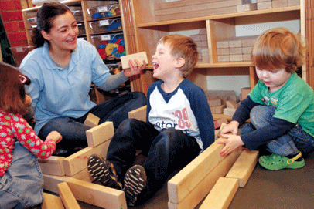
Children with this schema may enjoy:
Make bracelets & bangles
Farms & zoos
Use shoeboxes as houses or beds for toys
Dig tunnels in wet sand
Make picture frames
Tape & fabric to enclose spaces
Make caves with clay
Masks & crowns
Draw round each other
Make doors for dens, tunnels & barrels
Doctors & bandages

Slide 17
All the information in this hand-out is taken
from this book
Again! Again! Understanding Schema in young children
written by Stella Louis, Clare Beswick, Liz Magraw & Lisa Hayes
Published by Featherstone Education

Slide 18
further reading
Thanet Early Years Blog http://thanetearlyyearsproject.blogspot.com/
Arnold, C (1999) Child Development and Learning 2-5 years: Georgia's Story, Sage, London
Arnold, C (2003) Observing Harry: Child Development and Learning 0-5 years, Open University Press, Maidenhead
Nutbrown, C (1999) Threads of Thinking (second edition). Paul Chapman, London
Whalley, M (ed) (2001) Involving Parents in their Children's Learning, Paul Chapman, London
Athey, C (2007) Extending thought in Young Children: a parent – teacher partnership, Paul Chapman, London

